Slide 1
Functions of Human Bodies
Katherine Puskarz
Pre-Nursing @ District 1199c Training & Upgrading Fund

Slide 2
Adaptation/Response to Stimuli
Receive, interpret, and respond to internal and external stimuli
Two types:
External
Internal

Slide 3
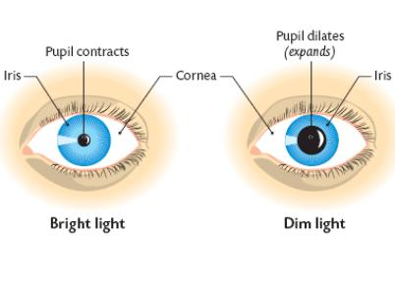
Adaptation: External
http://leavingbio.net/the%20senses_files/the%20senses.htm

Slide 4
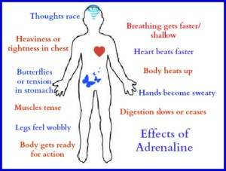
Adaptation: Internal
http://drsarahallen.com/wp-content/uploads/2014/08/Effects-of-adrenaline1-300x227.jpg

Slide 5
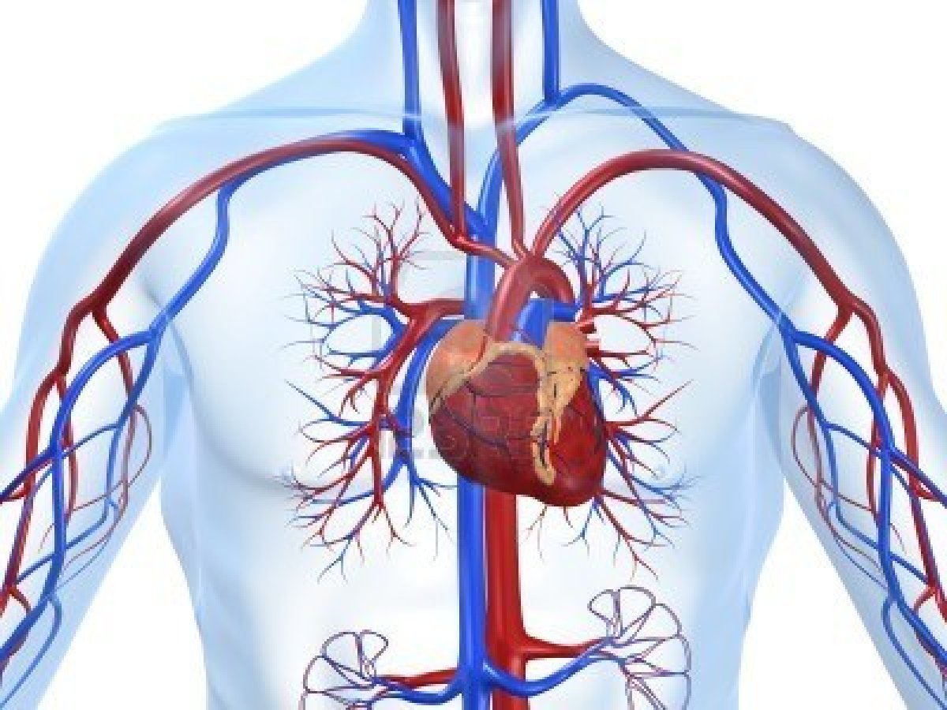
Circulation
Transport oxygen and other nutrients to tissues via the cardiovascular system
http://dxline.info/img/new_ail/cardiovascular-system.jpg

Slide 6
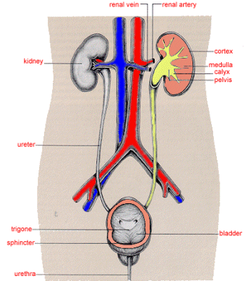
Elimination
Removal of metabolic waste from the body via the renal (urinary) system
http://www.le.ac.uk/pa/teach/va/anatomy/case4/kid1.gif

Slide 7
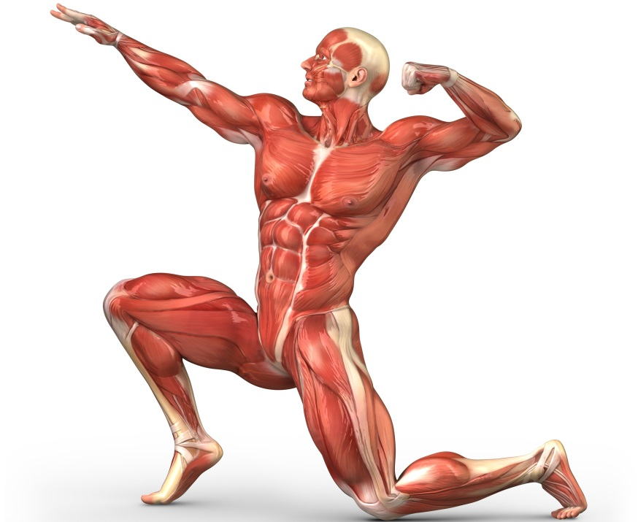
Locomotion
Allow voluntary and involuntary movement of body via the musculoskeletal and neurological systems
http://www.onlinehumananatomycourse.net/wp-content/uploads/2013/01/Functions-Of-The-Muscular-System.jpg

Slide 8
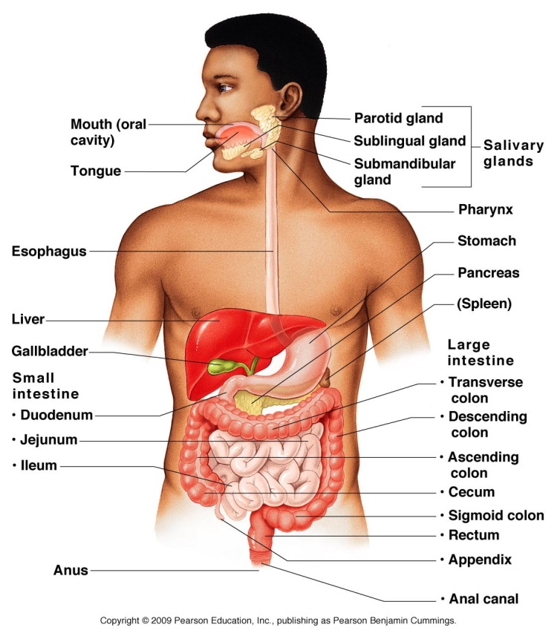
Nutrition
Take in and break down nutrients to be used for metabolism via the digestive system
http://droualb.faculty.mjc.edu/Course%20Materials/Elementary%20Anatomy%20and%20Physiology%2050/Lecture%20outlines/14_01Figure-L.jpg

Slide 9
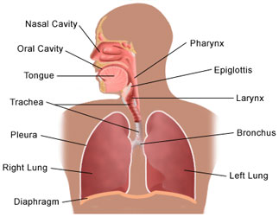
Oxygenation
Take in oxygen and expel carbon dioxide via the respiratory system
https://findfunfacts.appspot.com/human_body/images/respiratory.jpg

Slide 10
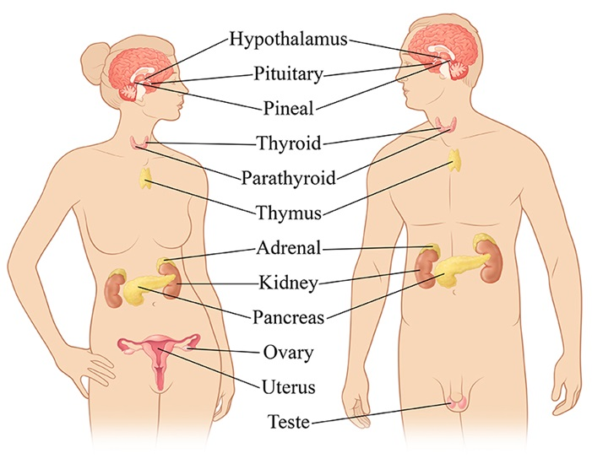
Regulation
Hormonal control of body functions via the endocrine system
Homeostasis = maintain internal body conditions
http://www.hormone.org/~/media/Hormone/Images/Endo%20101/RGB%20Image%20for%20Site.jpg?h=550&w=701

Slide 11
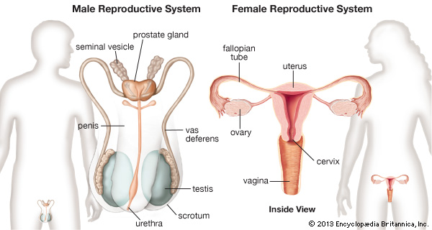
Self-duplication
Production of offspring via the reproductive system
Only possible with DNA (deoxyribonucleic acid)
Meiosis produces sperm and egg which then combine to create a genetically unique individual
http://media-2.web.britannica.com/eb-media/31/94931-004-4DED6AD1.jpg

