Slide 1
Matter, Energy, Work, Electromagnetic Waves

Slide 2
Matter, Energy and Work
Our universe is made of up matter and energy
  Matter = “stuff” that has mass and takes up space
  Work = the product of the magnitude of the force and the parallel distance through which the object moves
  Energy = the ability to do work or cause change

Slide 3
Work
Process by which energy is transferred from one object to another
Involves both force and motion
Work = force x distance
W = Fd
The unit of work is the joule (j) or N·m
  Force (F) is measured in newtons (N)
  Distance (d) is measured in meters (m)
  1 J = 1 N·m

Slide 4
Force
Force = push or pull
Forces are the cause of action, even when nothing is moving

Slide 5
Newton’s First Law of Motion
An object at rest stays at rest and an object in motion stays in motion with the same speed and in the same direction unless acted upon by an unbalanced force.
Most of the time, those “unbalanced forces” are due to friction or gravity
If you kick a soccer ball on frictionless ice, it will continue in a straight line forever

Slide 6
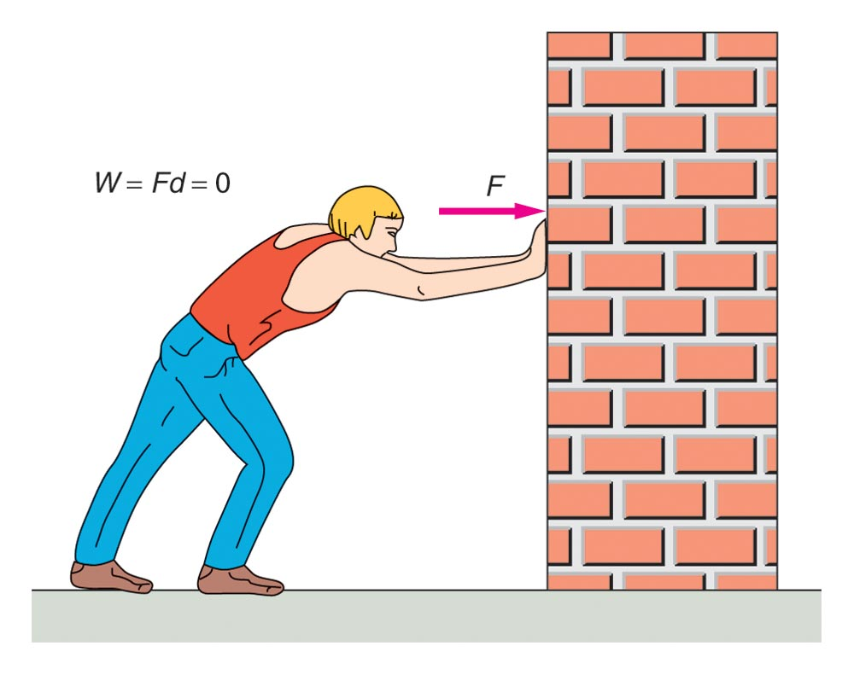
No work is done because there is no movement (d = 0)

Slide 7
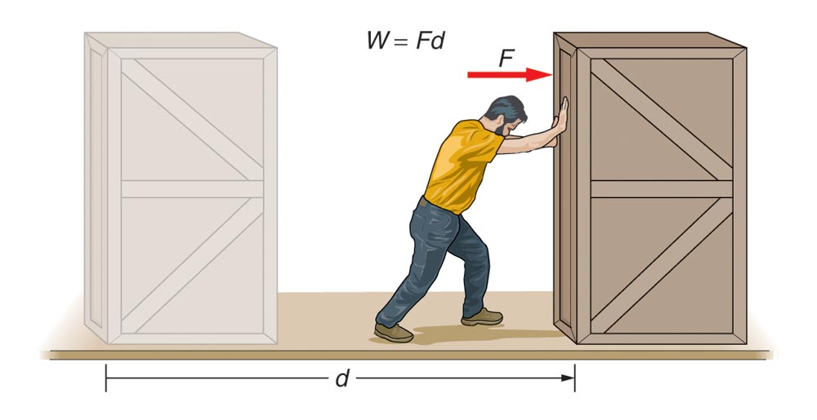
Work IS being done because force (F) is being applied over a distance (d)

Slide 8
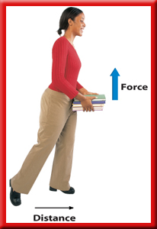
Your arms are NOT working because the direction of the force (F) is not the same direction as the distance

Slide 9
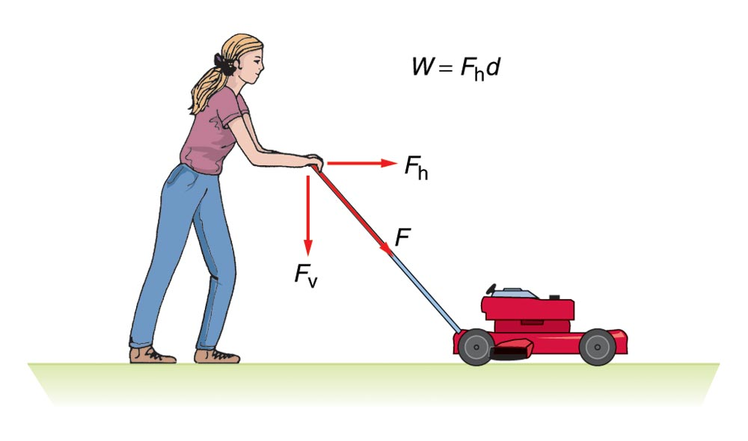
Work in the horizontal component
NO WORK in the vertical component (d=0)
When you move the lawn mower you are really exerting force in TWO directions

Slide 10
Newton’s Third Law of Motion
For every action, there is an equal and opposite reaction
In other words, forces interact with each other
Most of the time those forces will be gravity and friction
  When you are standing, gravity is exerting a downward force on you and your muscles are exerting an upward force
  Because the forces are equal, but opposite, you are able to remain upright (no flying, no being pulled to the ground)

Slide 11
Energy and Joules
All types of energy are measured in tiny units called joules (J) … remember that work is also measured in joules
You may also hear these terms when discussing energy
  Amps or amperes = measures electrical current
  Volts = measures electrical energy
  Calories = measures amount of energy need to change the temperature of one gram of water 1°C

Slide 12
Law of the Conservation of Energy
Energy cannot be created or destroyed
Energy can change forms
The total energy of an isolated system remains constant
(total energy)_{time1} = (total energy) _{time2}

Slide 13
Energy
THERMAL
internal motion of particles
The ability to cause change.
ENERGY
NUCLEAR
MECHANICAL
changes in the nucleus
motion of objects
CHEMICAL
ELECTRICAL
bonding of atoms
Measured in
motion of electric charges
joules (J)

Slide 15
Kinetic Energy
The energy an object possesses because of its motion
Also called the energy of motion
kinetic energy = ½ x mass x (velocity)²
E_{k} = ½mv²
(If an object is already moving)
Work = change (Δ) in kinetic energy
W = ΔΕ_{k} = E_{k2} – E_{k1} = ½mv₂² - ½mv₁²

Slide 16

Kinetic Energy (KE)
Which has the most KE?
80 km/h truck
Which has the least KE?
50 km/h
km/h = kilometer per hour
80 km/h
50 km/h
80 km/h

Slide 17
Kinetic Energy Example
A 1.0 kg ball is fired from a cannon. What is the change in the ball’s kinetic energy when it accelerates from 4.0 m/s to 8.0 m/s?
GIVEN: m = 1.0 kg; v₁ = 4.0 m/s; v₂ = 8.0 m/s
ΔΕ_{k} = E_{k2} – E_{k1} = ½mv₂² - ½mv₁²
ΔE_{k} = ½(1.0 kg)(8.0 m/s)² – ½(1.0 kg)(4.0 m/s)²
ΔE_{k} = 32J – 8.0J =
24J

Slide 18


Potential Energy (PE)
The energy an object has because of its position or location
Also known as the energy of position
Most is due to gravity
Other examples include
  Springs (compressed or stretched)
  Bowstrings
This boulder has greater PE

Slide 19
Gravitational Potential Energy
The gravitational potential energy (E_{p}) is equal to the work (W) done and this is equal to the weight (mg) times the height (h)
W = E_{p} = mgh
m = mass of an object
g = standard gravity constant = 9.8 m/s²

Slide 20
Gravitational Potential Energy Example
How much work is done lifting a 1.0 kg book to the height of 1m?
Work = W = (1.0 kg) (9.8 m/s²) (1m) = 9.8 J
This is also the amount of E_{p} that the book has at a height of 1m

Slide 21
Kinetic and Potential Energy: Law of Conservation of Energy
As potential energy increases, kinetic energy decreases
As the kinetic energy increases, the potential energy decreases
The total energy of the system never changes
WHY? Because energy changes from kinetic to potential and back (but is never lost/gained)
PE ⇔ KE

Slide 22
Forms of Energy
Thermal (heat) Energy – related to the kinetic and potential energies on a molecular level
Gravitational potential energy – from an object’s position, stored gravitational energy
Electrical energy – associated with the motion of electric charges
Chemical energy – molecular bonds
Radiant energy – sun
Nuclear energy – rearrangement of nuclei
  Fission – breaking apart of larger nuclei
  Fusion - smaller nuclei are put together

Slide 23
Heat Energy
All matter contains heat energy
The higher the temperature, the more heat energy there is
  You put energy in to make something warmer
  You take energy out to make something colder
Humans have created technology that transforms heat energy to other forms

Slide 24
Heat and Kinetic Energy
Energy of motion
Heat is actually kinetic energy
The “feeling of heat” is the energy moving between more-energetic atoms to the less-energetic atoms

Slide 25
Waves
Waves carry energy (not matter) through a variety of mediums
  Water waves (liquid) will bob you up and down but not sideways.
  Earthquakes waves move through the earth. (solid)
  Sound waves travel through the air. (gas)
  Electromagnetic radiation waves travel through space. (void)
  Mediums = material through which a wave transfers energy

Slide 26
Longitudinal and Transverse Waves
Two types of waves classified on their particle motion and wave direction:
Longitudinal – particle motion and the wave velocity are parallel to each other
  Sound is a longitudinal wave.
Transverse – particle motion is perpendicular to the direction of the wave velocity
  Light is an example of a transverse wave.

Slide 27
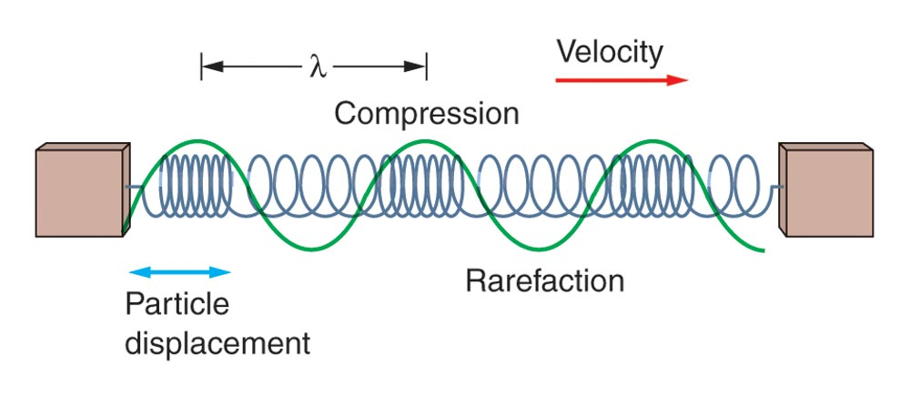
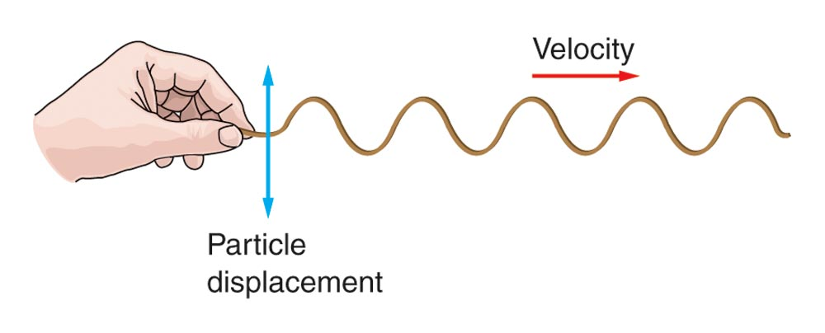
Longitudinal and Transverse Waves
Longitudinal Wave
Transverse Wave

Slide 28
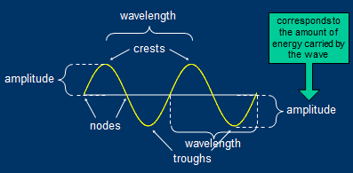
Transverse Waves

Slide 29
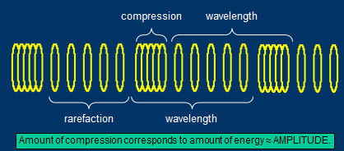
Longitudinal Waves

Slide 30
Wave Description
Wavelength (λ) = distance of one complete wave (crest to crest or node to node)
Amplitude = maximum displacement of any part of the wave from its equilibrium position
Frequency (f) = number of oscillations or cycles that occur during a given time (1 sec)
  The unit usually used to describe frequency is the hertz (Hz).
  One Hz = one cycle per second
  Shorter wavelength = higher frequency = higher energy
Period (T) = the time it takes for a wave to travel a distance of one wavelength

Slide 31
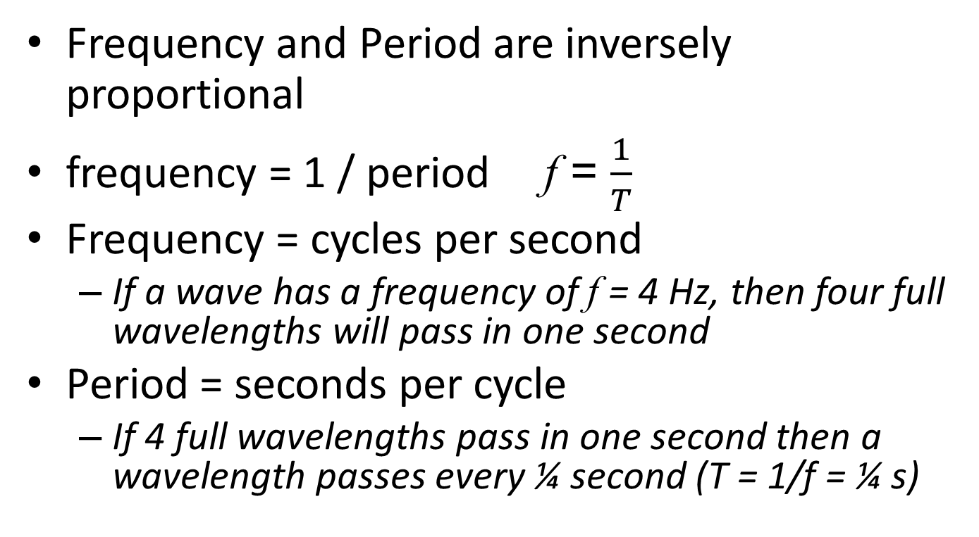
Frequency and Period
Frequency and Period are inversely proportional
frequency = 1 / period f = $\frac{1}{T}$
Frequency = cycles per second
  If a wave has a frequency of f = 4 Hz, then four full wavelengths will pass in one second
Period = seconds per cycle
  If 4 full wavelengths pass in one second then a wavelength passes every ¼ second (T = 1/f = ¼ s)

Slide 32
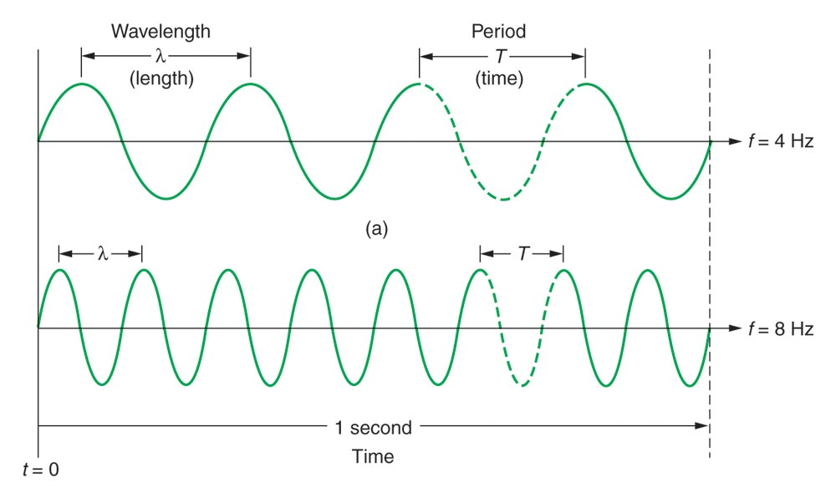
T= ¼ s
T= 1/8 s

Slide 33
Electromagnetic Waves
Consist of vibrating electric and magnetic fields that oscillate perpendicular to each other and the direction of wave propagation
ALL electromagnetic waves travel at the speed of light
  c = 3.00 x 10⁸ m/s = 1.86 x 10⁵ mi/s

Slide 34
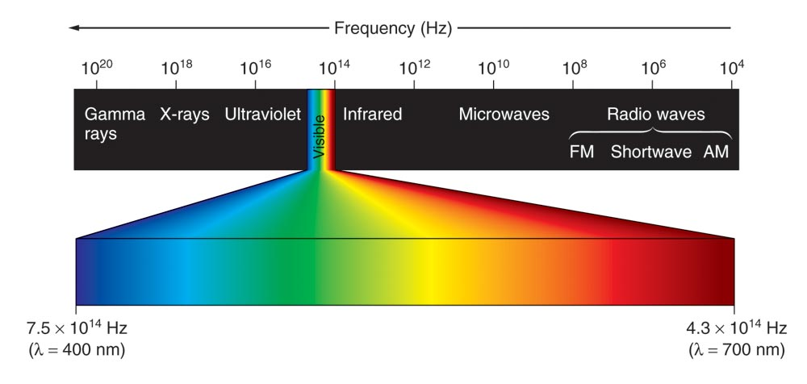
Electromagnetic (EM) Spectrum
The human eye is only sensitive to a very narrow portion of the electromagnetic spectrum (lying between the infrared and ultraviolet.) We call this “light.”
Section 6.3

Slide 35
Electromagnetic (EM) Spectrum
The entire range of EM waves in order of increasing frequency and decreasing wavelength
  As you move from left to right, the wavelengths get smaller and the frequencies get higher
  This is an inverse relationship between wavelength and frequency
  WHY? All EM waves travel at the speed of light
  Speed or velocity = wavelength x frequency

Slide 36
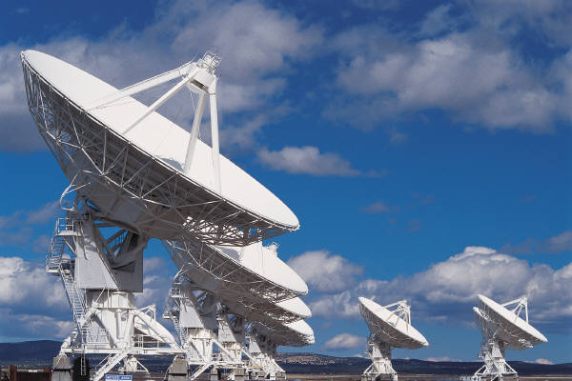
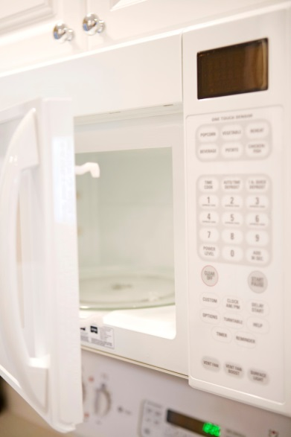
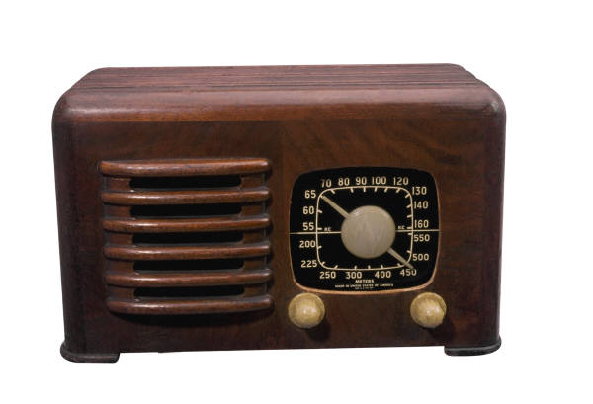
Radio Waves
Have the longest wavelengths and the lowest frequencies; wavelengths range from 1000’s of meters to .001 meters
Used in: RADAR, cooking food, satellite transmissions

Slide 37
Infrared Waves (heat)
Have a shorter wavelength, from .001 m to 700 nm, and therefore, a higher frequency.
Used for finding people in the dark and in TV remote control devices

Slide 38
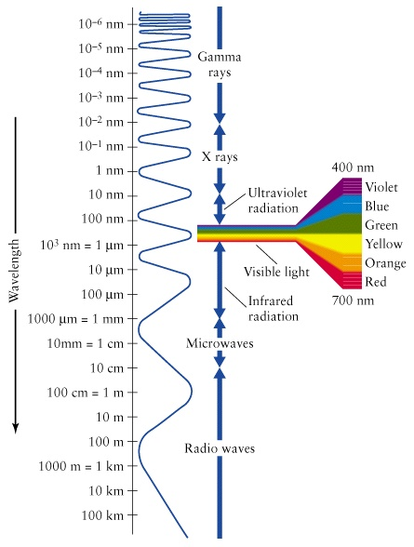
Visible Light
Wavelengths range from 700 nm (red light) to 30 nm (violet light) with frequencies higher than infrared waves.
These are the waves in the
EM spectrum that humans
can see.
Visible light waves are a very
small part of the EM spectrum!

Slide 39
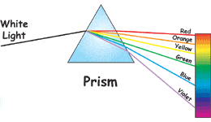
Visible Light
Remembering the Order
ROY G. BIV
  red
  orange
  yellow
  green
  blue
  indigo
  violet
Notes:
Light from the sun looks white, but it is really made up of all the colors of the rainbow. A prism is a specially shaped crystal. When white light shines through a prism, the light is separated into all its colors.

Slide 40

Ultraviolet Light
Wavelengths range from 400 nm to 10 nm; the frequency (and therefore the energy) is high enough with UV rays to penetrate living cells and cause them damage.
Although we cannot see UV light, bees, bats, butterflies, some small rodents and birds can.
UV on our skin produces vitamin D in our bodies. Too much UV can lead to sunburn and skin cancer. UV rays are easily blocked by clothing.
Used for sterilization because they kill bacteria.

Slide 41
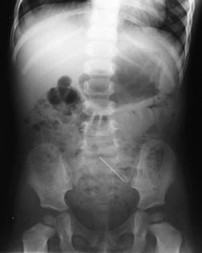
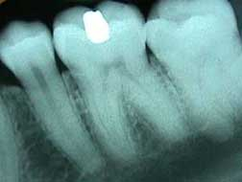
X-rays
Wavelengths from 10 nm to .001 nm. These rays have enough energy to penetrate deep into tissues and cause damage to cells; are stopped by dense materials, such as bone.
Used to look at solid structures, such as bones and bridges (for cracks), and for treatment of cancer.

Slide 42
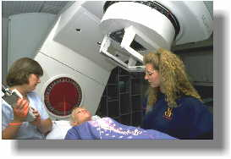
Gamma Rays
Carry the most energy and have the shortest wavelengths, less than one trillionth of a meter (10⁻¹²).
Gamma rays have enough energy to go through most materials easily; you would need a 3-4 ft thick concrete wall to stop them!
Gamma rays are released by nuclear reactions in nuclear power plants, by nuclear bombs, and by naturally occurring elements on Earth.
Sometimes used in the treatment of cancers.

