Slide 1
Acid, Bases and Water

Slide 2
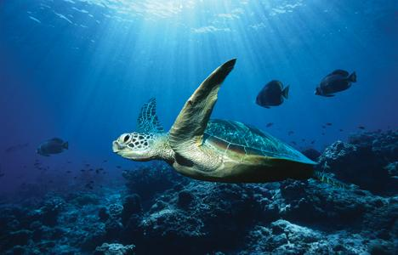
Chemistry of Water
1. All living things are 70.90% water.
2. Because water is a polar molecule, water molecules are hydrogen bonded to each other. 3. With hydrogen bonding, water is liquid between 0°C and 100°C which is critical for life.

Slide 3
Chemical Structure
1. Water is composed of 2 hydrogen atoms and 1 oxygen atom so it’s chemical formula is H₂O
2. Water contains POLAR COVALENT BONDS between hydrogen and oxygen atoms
a. COVALENT means that the electrons are shared between the atoms
b. POLAR means that the sharing is not equal
- oxygen is more electronegative so it tends to hog to the shared electrons. As a result, it has a slightly negative charge
- hydrogen has a slightly positive charge
Electronegativity is a measure of the tendency of an atom to attract a bonding pair of electrons.

Slide 4
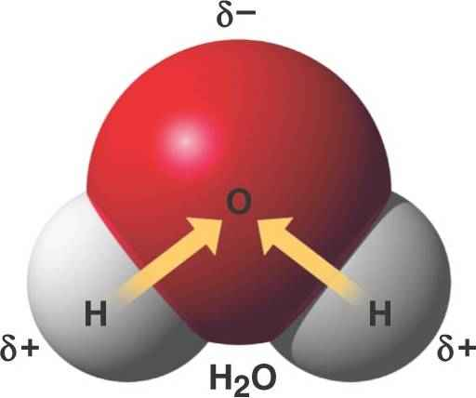
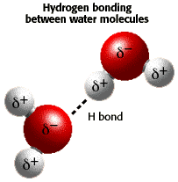
3. As a result of the slight charges on the water molecule, HYDROGEN bonds can form between water molecules, which can account for some of its properties

Slide 5
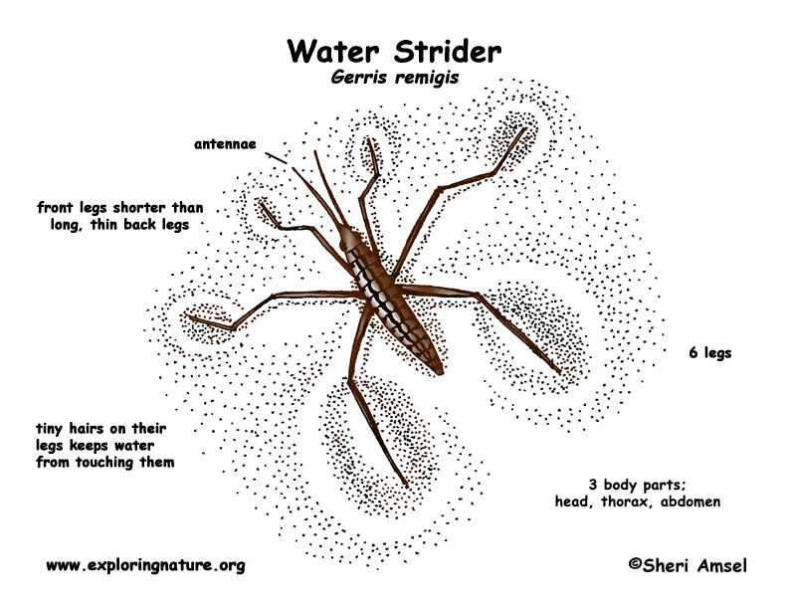
Properties of Water
1. Water can be attracted to itself and other compounds
b. COHESION = an attraction between molecules of the same substance
b. ADHESION = an attraction between molecules of different substances
Water striders use cohesion to seemingly walk on water. Cohesion between water molecules creates SURFACE TENSION at the surface of the water. The surface water molecules bond very strongly to each other and as long as the water strider doesn’t break those bonds, he can walk across the surface.

Slide 6
2. The temperature of liquid water rises and falls more slowly than that of most other liquids..
a. CALORIE is amount of heat energy required to raise temperature of one gram of water 1°C. b. Because water holds more heat, its temperature falls more slowly than other liquids; this protects organisms from rapid temperature changes and helps them maintain normal temperatures.

Slide 7
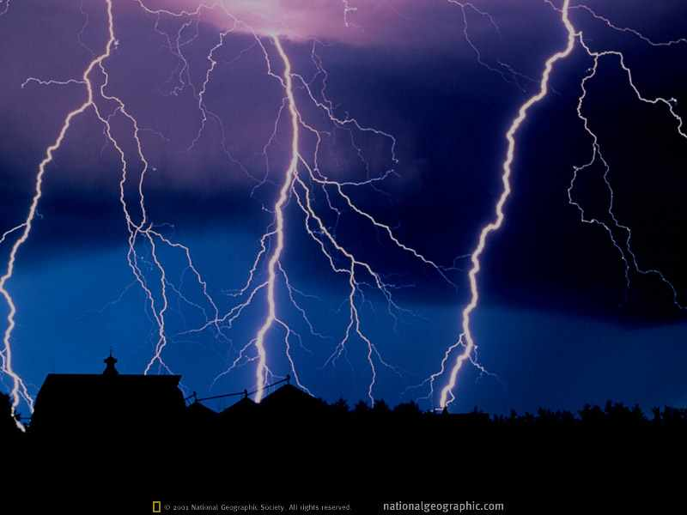
3. Pure water possesses a low electrical conductivity (ability to conduct an electrical charge)
a. When you add other compounds, like NaCl to water, you increase the conductivity
b. This is why lifeguards make you get out of the pool when there is lightning

Slide 8
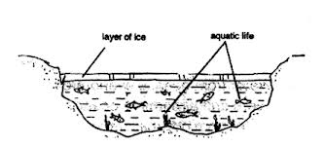
4. Water has a maximum density at 4°C
a. density = mass/volume
b. Celsius = metric temperature scale
c. This means that ice is less dense than liquid water, so it floats
- it also explains why aquatic creatures can still survive in frozen ponds (only the surface is frozen!).

Slide 9
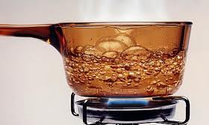
5. The boiling point of water depends on the pressure
a. At sea level (Philadelphia), water boils at 100°C
b. At 5,280 feet above sea level (Denver), water boils at 95°C
c. At 29,000 feet above sea level (peak of Mt. Everest), water boils at 68°C

Slide 10
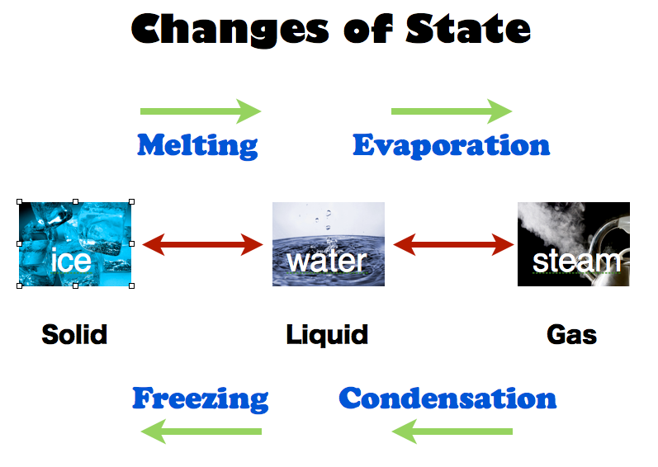
6. Water can coexist as a solid, liquid and gas!
a. The TRIPLE-POINT of water is the temperature and pressure at which water will coexist as a solid (ice), liquid and gas (steam)
b. Kelvin (K) is another metric temperature scale that is based off the triple-point
273.16 K = 0.01°C TRIPLE-POINT
0 K = -273°C ABSOLUTE ZERO

Slide 11
7. Water has the second highest SPECIFIC HEAT (ammonia has the highest)
a. SPECIFIC HEAT = the energy required to raise one mass unit of a substance one degree Celsius
b. As a result, water undergoes minor temperature changes compared to the environment
- think about the beach … on superhot days the water feels cool because it’s slow to change temperature … and on super cold days, the water feels water because it’s slow to lose heat
Specific heat and calorie are the same thing for water: the amount of energy required to heat one gram of water one degree Celsius.

Slide 12
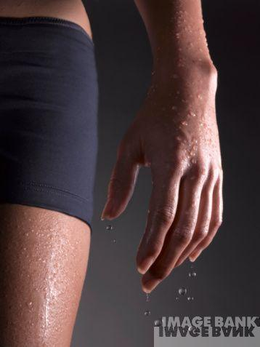
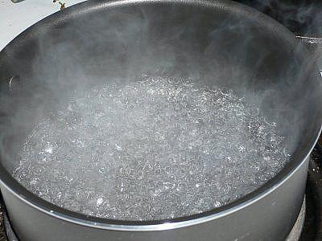
8. Water has a HIGH HEAT OF VAPORIZATION
a. HEAT OF VAPORIZATION = the amount of heat necessary to cause a phase transition between a liquid and gas
b. WHY? Hydrogen bonds between water molecules require a large amount of heat to break c. This property moderates earth's surface temperature; permits living systems to exist here d. When animals sweat, evaporation of the sweat takes away body heat, thus cooling the animal

Slide 13
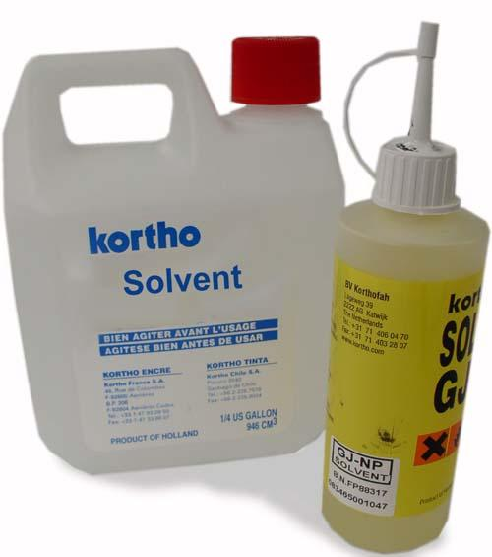
9. Water is UNIVERSAL SOLVENT
a. Water is a universal solvent because it dissolves a great number of solutes (substances that are dissolved)
b. Helps chemical reactions both outside of and within living systems
- anabolic reactions (creation of larger molecules)
- catabolic reactions (creation of smaller molecules)
c. Ionized or polar molecules attracted to water are HYDROPHILIC. d. Nonionized and nonpolar molecules that cannot attract water are HYDROPHOBIC.
If we use a simple and easy example, we can get a handle on the idea. Take a glass of warm water, put a teaspoon of table salt in it, and stir it. The salt will dissolve in the water and "disappear" from view. The water is the solvent here, the salt is the solute in this example, and the resulting salt water is a solution that we created. It's that simple.

Slide 14
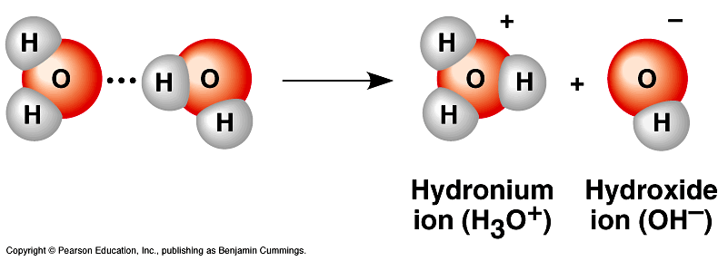
Acids and Bases
1. Covalently bonded water molecules ionize → atoms dissociate (split up) into ions
2. When water ionizes or dissociates, it releases a small but equal number of H⁺ and OH⁻ ions
a. equal positive and negative ions means charges are canceled out and pH is neutral
b. pH scale is based on the concentration of H+ ions
3. Water dissociates into hydrogen (H⁺) and hydroxide (OH⁻) ions:

Slide 16
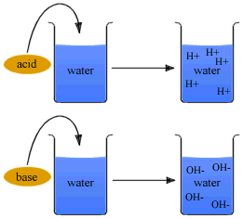
4. Acid molecules dissociate in water, releasing hydrogen ions (H⁺) ions: HCl ¨ H⁺ and Cl⁻
5. Bases are molecules that take up hydrogen ions or release hydroxide ions: NaOH ¨ Na⁺ + OH⁻

Slide 17
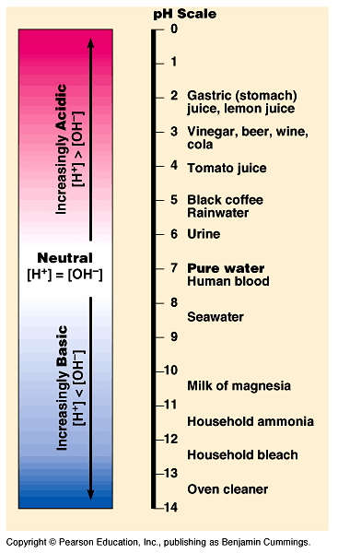
6. The pH scale indicates acidity and basicity (alkalinity) of a solution.
* pH is really a measure of H⁺ ions
1) Pure water has neutral pH of 7 2) Acid is a substance with pH less than 7
3) Base is a substance with pH greater than 7 4) As logarithmic scale, each lower unit has 10 times the amount of hydrogen ions as next higher pH unit;
* Buffers keep pH steady and within normal limits in living organisms.

Slide 18
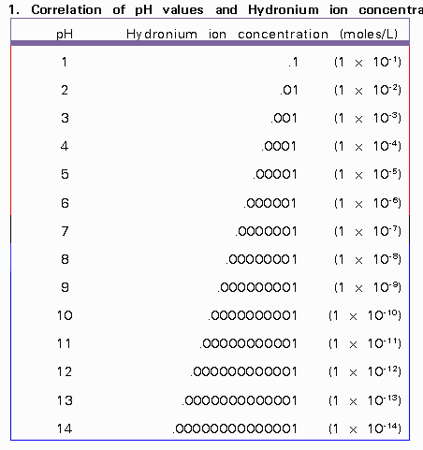
7. pH can be calculated using the formula:
pH = - log (a_{H})
8. A logarithmic scale is used to rescale really large numbers (or really small ones) into values much closer to 1
pH = - log (a_{H})
pH = - log (1 x 10⁻³)
pH = - (-3)
pH = 3

Slide 19
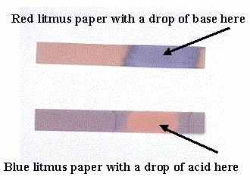
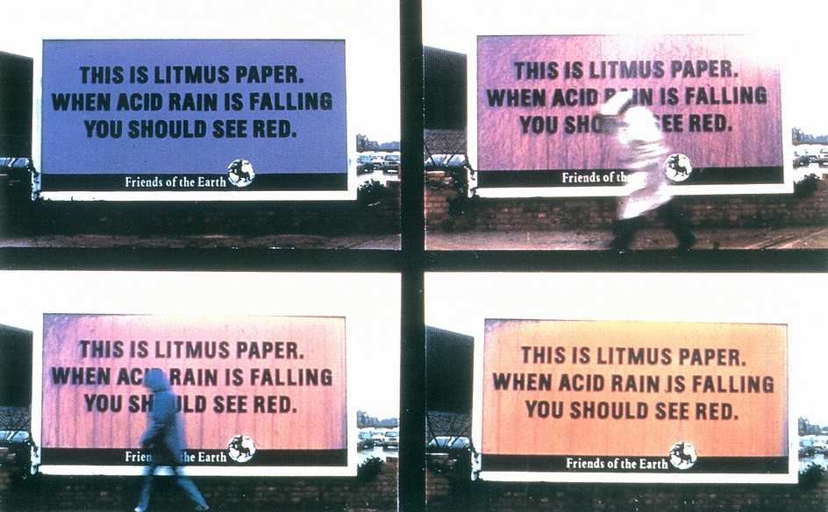
9. if you need to find the pH of a substance but don’t know the a_{H}, use a pH indicator
a. pH indicators change colors based on whether they are placed in an acid or base
b. Litmus paper
- RED for acidic solution
- BLUE for basic solutions

